Slide 1
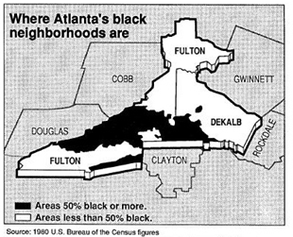
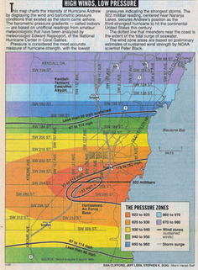
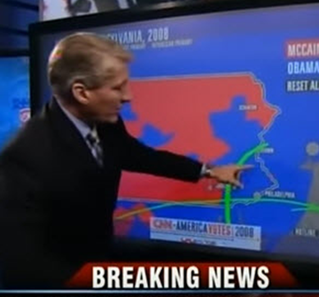
Data Journalism
Michael Friendly
Psych 6135
https://friendly.github.io/6135/

Slide 2
Topics
What is DDJ?
Some early examples
Modern examples
election reporting
health statistics
social media
Best examples??
Now trending

Slide 3
What is data journalism?
Data journalism reflects the increased role of numerical data for reporting in the digital era. Data driven or DDJ more useful
Reflects increased interaction between journalists and {visualization design, computer science and statistics}.
Aspects:
Database analysis: FOI requests on topics like crime, racial discrimination, judicial sentencing, toxic pollution, …
Visualization: infographic←→data vis., emphasis on the story
Increasing use & development of data vis. software tools
analysis: R, python, …
visualization libraries: R, D3, javascript, …
Increasing use of dynamic updating of data sources
election polls / prediction
disease tracking

Slide 4
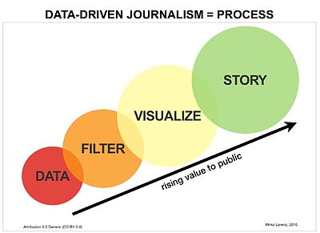

What is data journalism?
To an outsider, it is often hard to tell concretely what #DDJ is, or is not
Two motivational infographics of #DDJ as a process
How does it actually work?
What makes it successful?

Slide 5
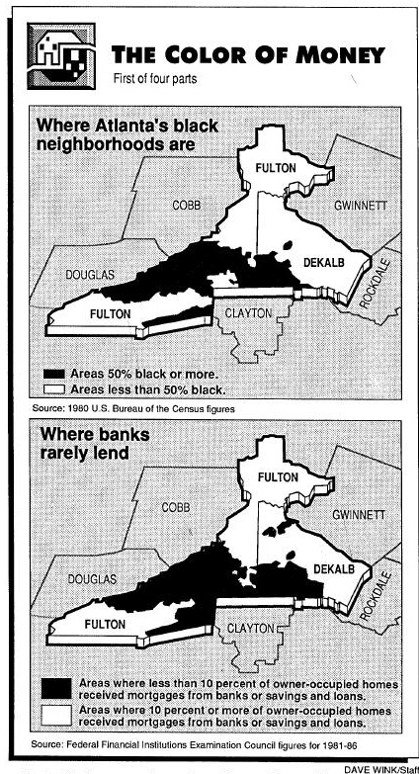
Bill Dedman: The Color of Money
Bill Dedman of The Atlanta Journal-Constitution analyzed racial discrimination by banks and other lenders in middle-income black neighborhoods of Atlanta, GA.
In a series of articles, May 1-4, 1988, The Color of Money, he showed that although banks made loans in even the poorest white neighborhoods, they did not lend in middle-class or more affluent black neighborhoods.
This work won the Pulitzer prize in investigative reporting in 1989.
It helped establish the idea of computer-assisted reporting and the importance of compelling visualizations in telling the story.
See: http://powerreporting.com/color/ for all the articles and images

Slide 6
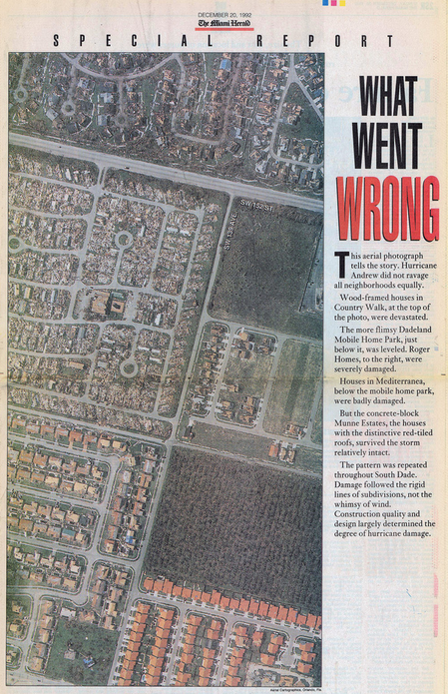
Hurricane Andrew
In Aug. 1992, a category 5 hurricane hit Miami-Dade county
Huge numbers of houses were destroyed, but this varied by neighborhood
Investigative reporters at the Miami Herald discovered why:
Building codes and inspection became lax after 1980.
Older homes survived.
This report by Liz Balmaseda et al. won the Pulitzer Prize in 1993.
destroyed
undamaged
Source: https://www.flickr.com/photos/juggernautco/sets/72157607210036175/

Slide 7
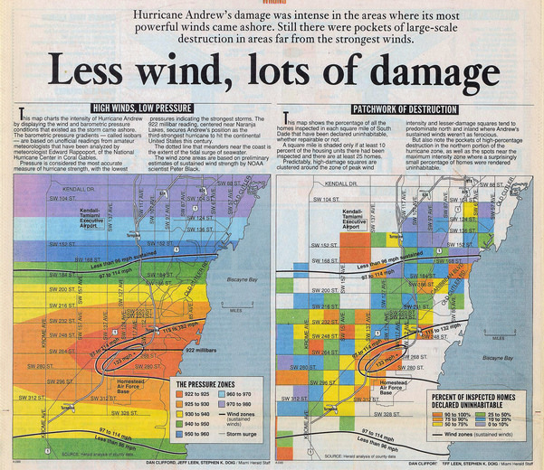
Hurricane Andrew
The report in the Miami Herald contained many detailed analysis maps
There was compelling evidence for the cause of destruction.
The combination of investigative reporting, analysis and graphics was seen as powerful

Slide 8
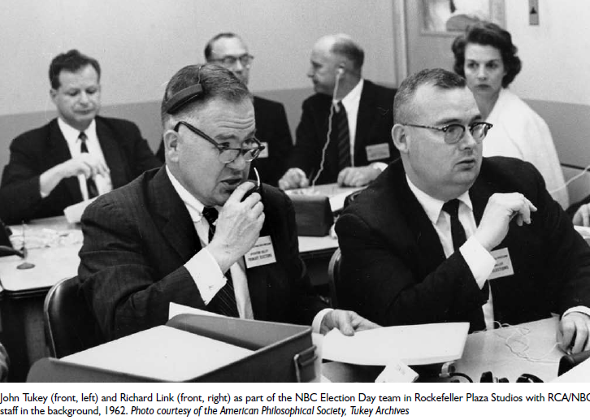
Predicting elections
In 1962, John Tukey and a statistical team joined with NBC to attempt to predict the congressional election
Over time, they developed new methods to combine past results with exit polls and current returns to give up-to-date estimates and measures of uncertainty as the numbers came in.
Key idea: “borrowing strength”
Now known as “hierarchical Bayes”
NBC execs were freaked out when the Tukey team began to call elections quite early with 95%, then 97.5% certainty.
They waited until it reached 99%, and missed the scoop.

Slide 9
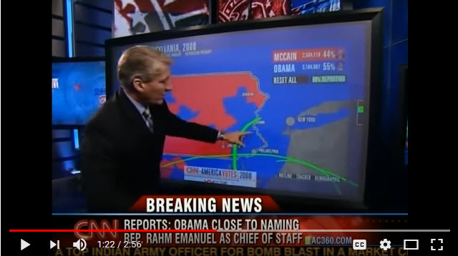
CNN Magic Wall
Direct, interactive visualization of election news on TV took a big jump with the development of the Magic Wall, a large touch-screen display, tied to databases of election results, and with on-screen controls to zoom in/out, compare, highlight, etc.
Video: https://www.youtube.com/watch?v=rpLHnK-MSy4

Slide 10
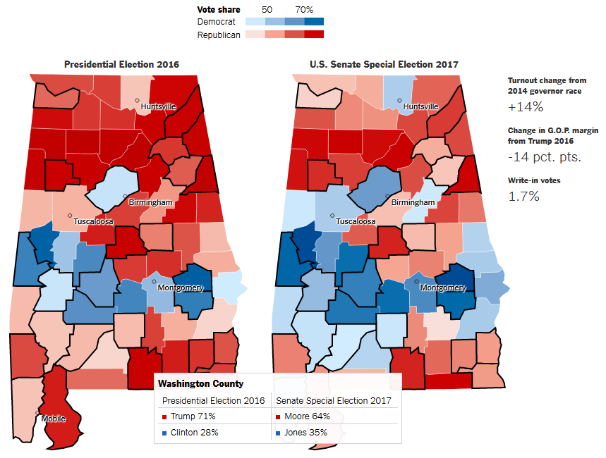
Election reporting: NYT
In the special election for the Alabama U.S. Senate, Dec. 12, 2017, The New York Times used dynamic, interactive maps to compare the vote to the 2016 Presidential election
Hovering the mouse over a county showed the details
A map-based display is natural & easy
Q: What other graphic might show the comparison better?

Slide 11
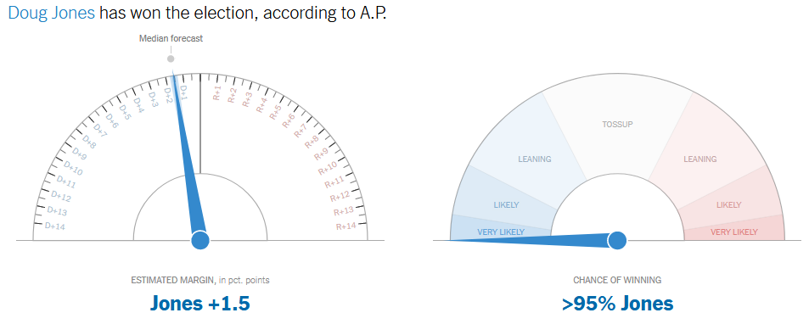
Election reporting: Dashboards
Throughout the evening of Dec. 12, the NYT dynamically updated dashboard displays of the election returns and model-based predictions of the winner
Two dials:
Predicted outcome
Certainty

Slide 12
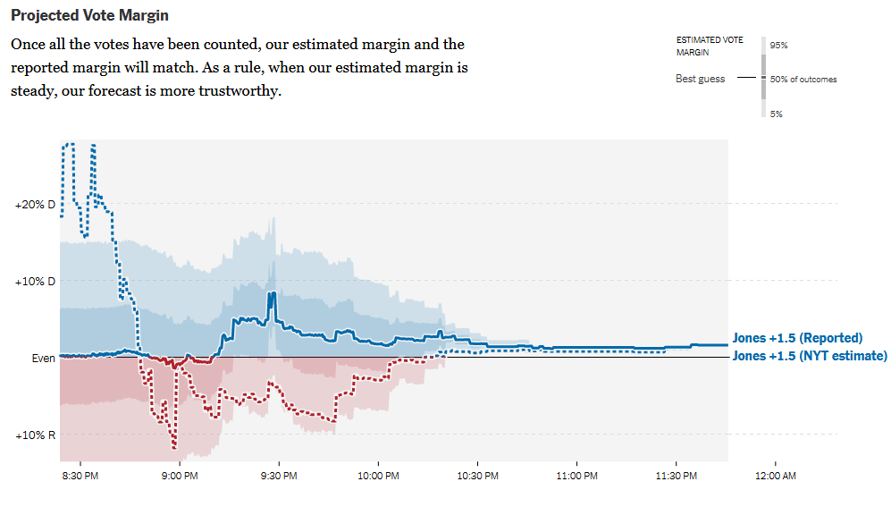
Election reporting: Dashboards
Another dynamically updated chart showed the projected vote margin, together with two levels (50%, 95%) of uncertainty intervals for the current estimate.

Slide 13
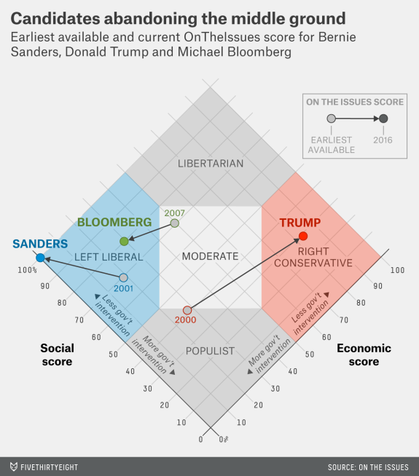
Novel graphic designs
This graph, from fivethirtyeight.com was designed to show how some presidential candidates had shifted positions before the 2016 election.
The axes are a score on social and economic policy, but they rotated the axes by 45º to create zones related to political thought.
This info graphic is eye-catching and self-explanatory:
colored/labeled zones
interpretive labels on axes
arrows showing movement to extremes

Slide 14
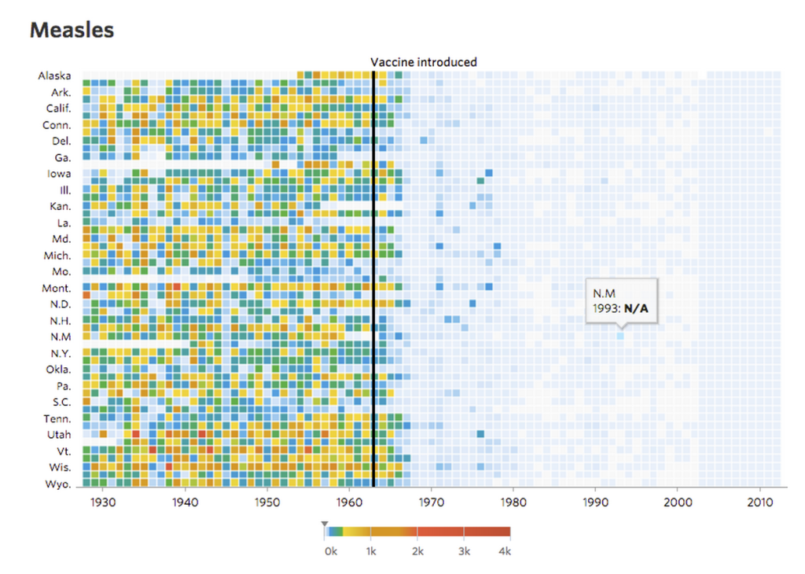
Measles and vaccines
Visualizing the impact of health policy interventions
In 2015 Tynan DeBold & Dov Friedman in the Wall Street Journal tried to show the effect of the introduction of vaccination programs in the US states on disease incidence, using color-coded heat maps for a variety of diseases
The long time series ~70 years made this work.
The heat map color scale is not exemplary, but the message is still clear: disease incidence declined after vaccines were introduced.
The images are “interactive,” in the weak sense that tool-tips are shown on mouse movement.
Source: http://graphics.wsj.com/infectious-diseases-and-vaccines/

Slide 15
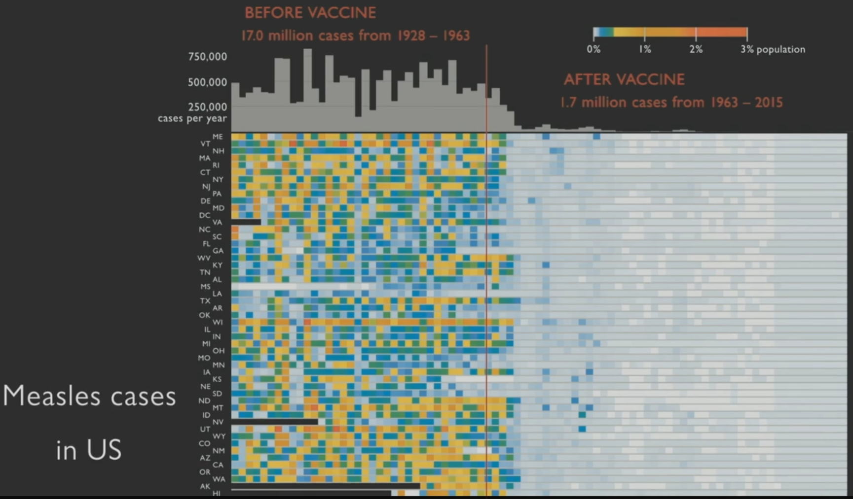
Making the message more explicit
What you should try to show here in an Info graphic is the overall impact of vaccination on measles
Ed Tufte did this by adding a histogram at the top showing total # of cases by year
With the overall impact made clear, details about individual states can now be explored

Slide 16
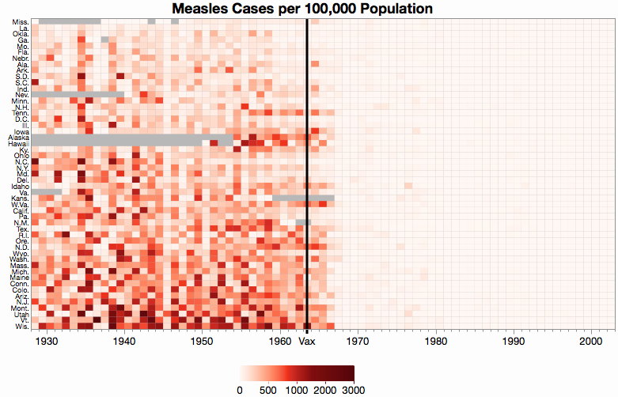
Effect ordering & color scales
Ordering the states by an overall measure of measles incidence makes it easier to study details.
A uni-dimensional scale of color is more effective than the ad-hoc scale used in the original
This chart, by Xan Gregg also shows missing data explicitly.
Color scales for data graphs is a growing topic.
What’s wrong in Wis. & VT?
From: https://community.jmp.com/t5/JMP-Blog/Graph-makeover-Measles-heat-map/ba-p/30550

Slide 17
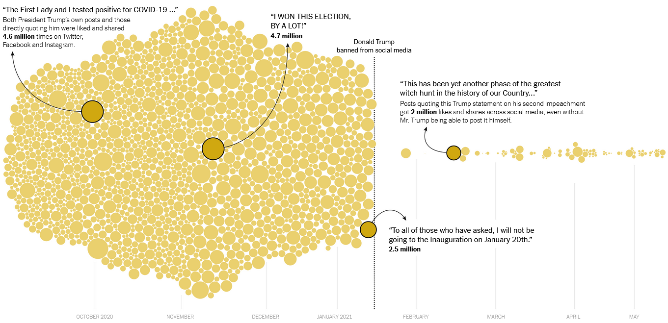
Before – After Circle Chart
What Happened When Trump Was Banned on Social Media?
Circles are statements by Trump.
Circle size ~ likes & shares on social media
https://www.nytimes.com/interactive/2021/06/07/technology/trump-social-media-ban.html

Slide 18
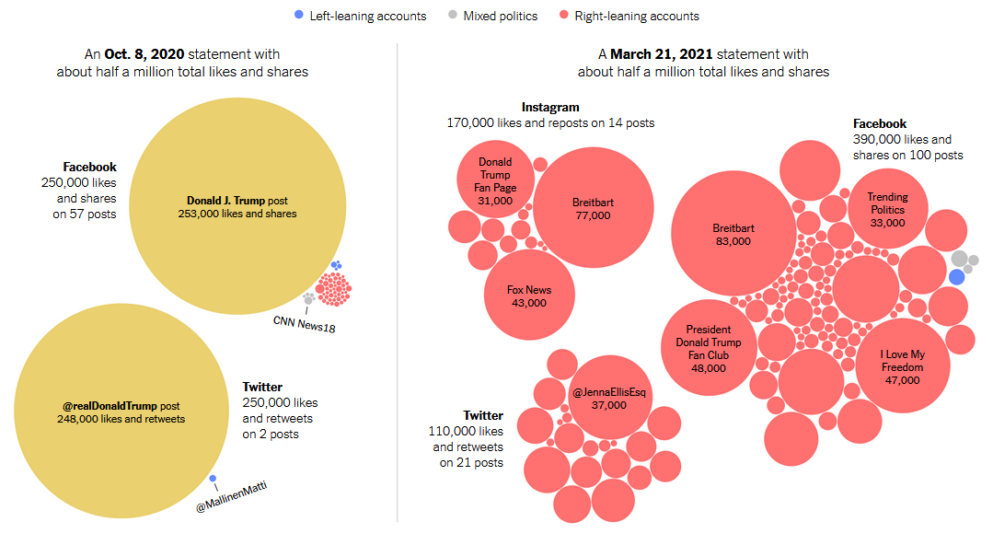
Before – After: Who pushed the lies?
How/Who Spread Trump statements before and after the ban
Posts referencing each Trump statement, sized by total number of likes and shares

Slide 19
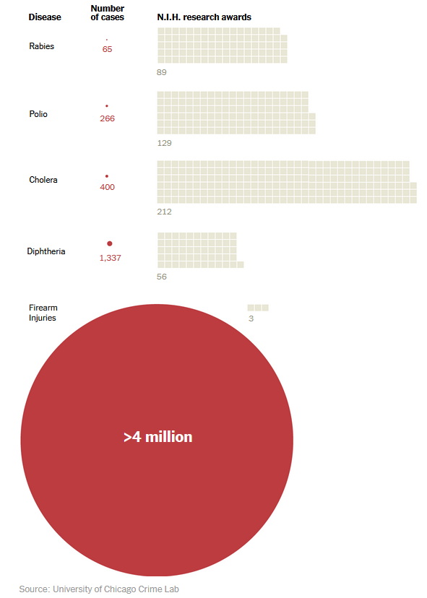
Health & research funding
This powerful NYT chart compares cases of diseases and firearm injuries to the number of N.I.H. research awards.
How well do you like this design?
Is it a fair depiction of the data?
Can you suggest anything different?

Slide 20
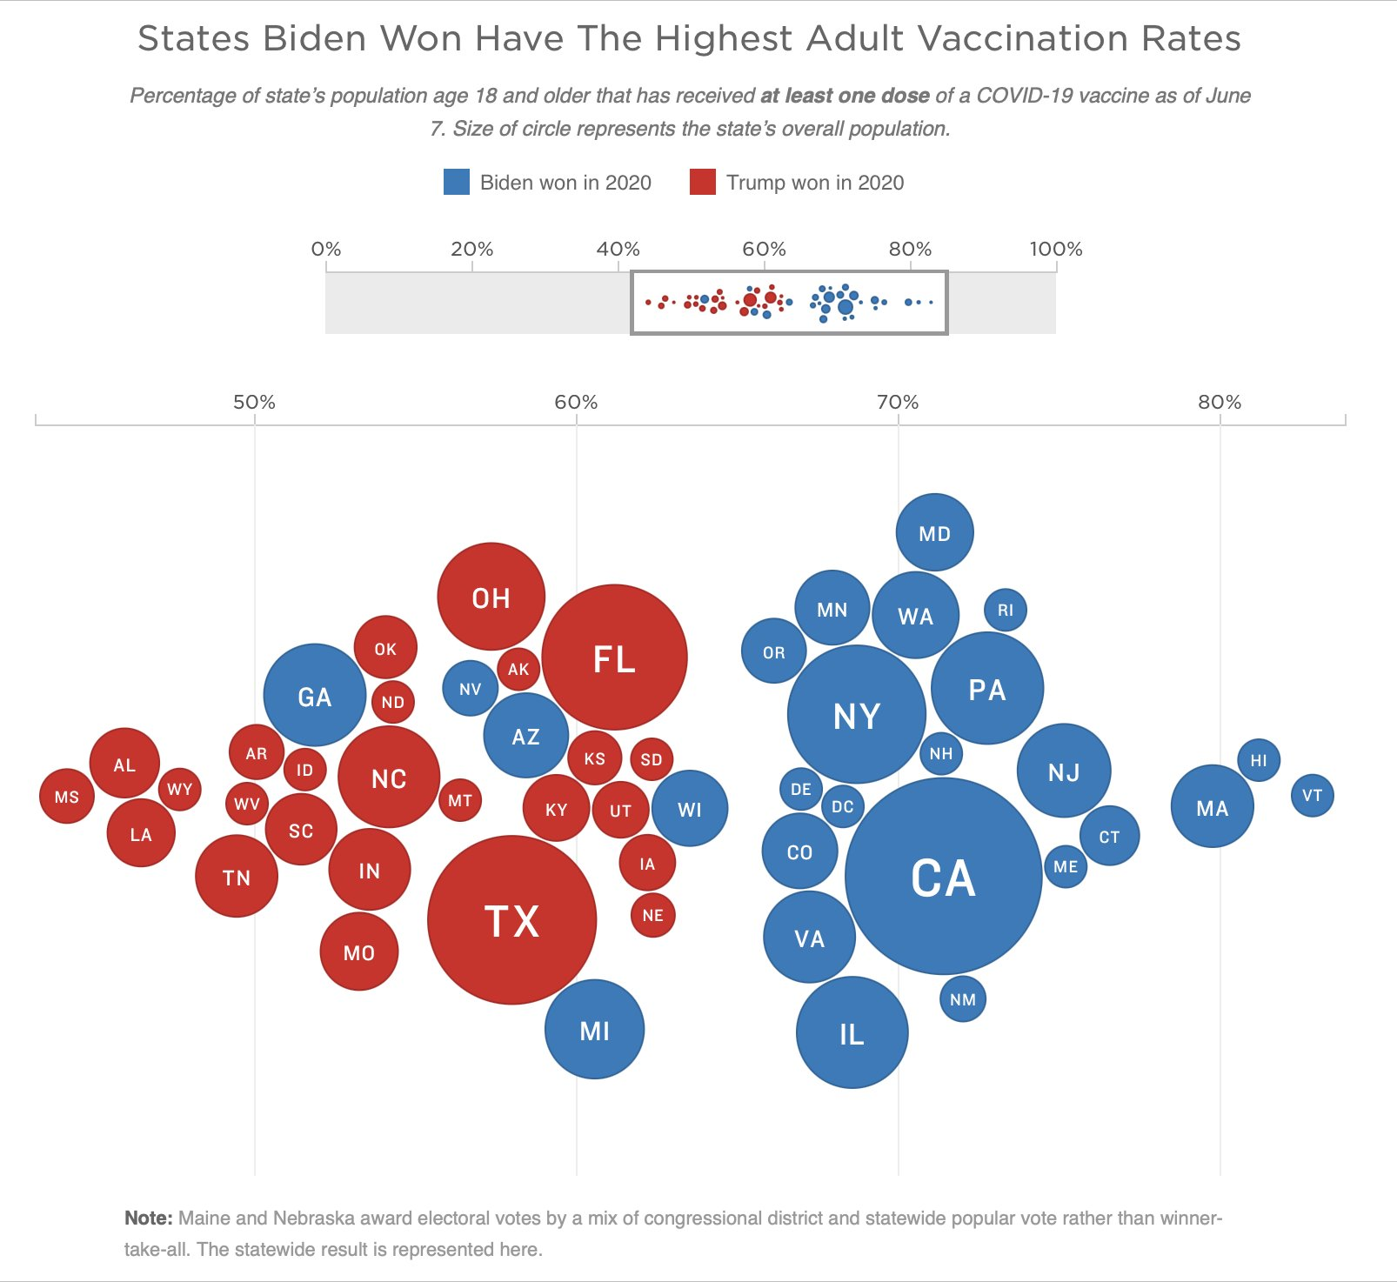
Votes for vs. COVID vaccinations
% of state pop. with at least one dose, vs. who won in 2020
circle size ~ state pop.
From: https://twitter.com/kjhealy/status/1402691186826039301

Slide 21
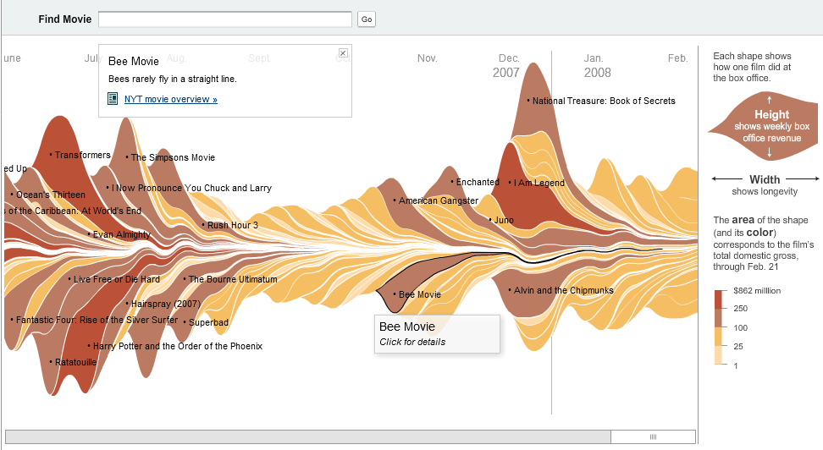
Infographics
An attractive, interactive graphic showing box office receipts for movies
But: How easy is it to compare different movies?
Bloch, M., Byron, L., Carter, S., and Cox, A. (2008). The ebb and flow of movies: Box office receipts 1986-2008. New York Times, 23 Feb. http://www.nytimes.com/interactive/2008/02/23/movies/20080223_REVENUE_GRAPHIC.html

Slide 22
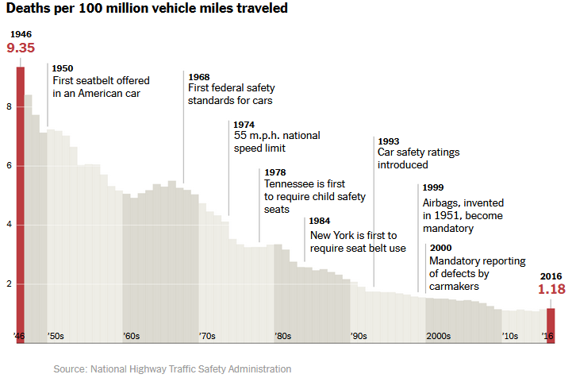
Seatbelts
New York Times: An annotated chart of vehicle deaths in relation to seatbelts
Telling the story of a public safety policy with explanatory milestones

Slide 23
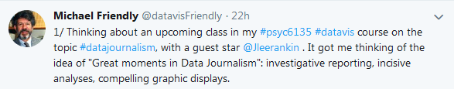

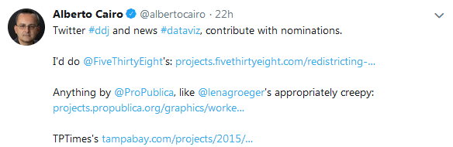
Best examples of DDJ? Ask Twitter

Slide 24
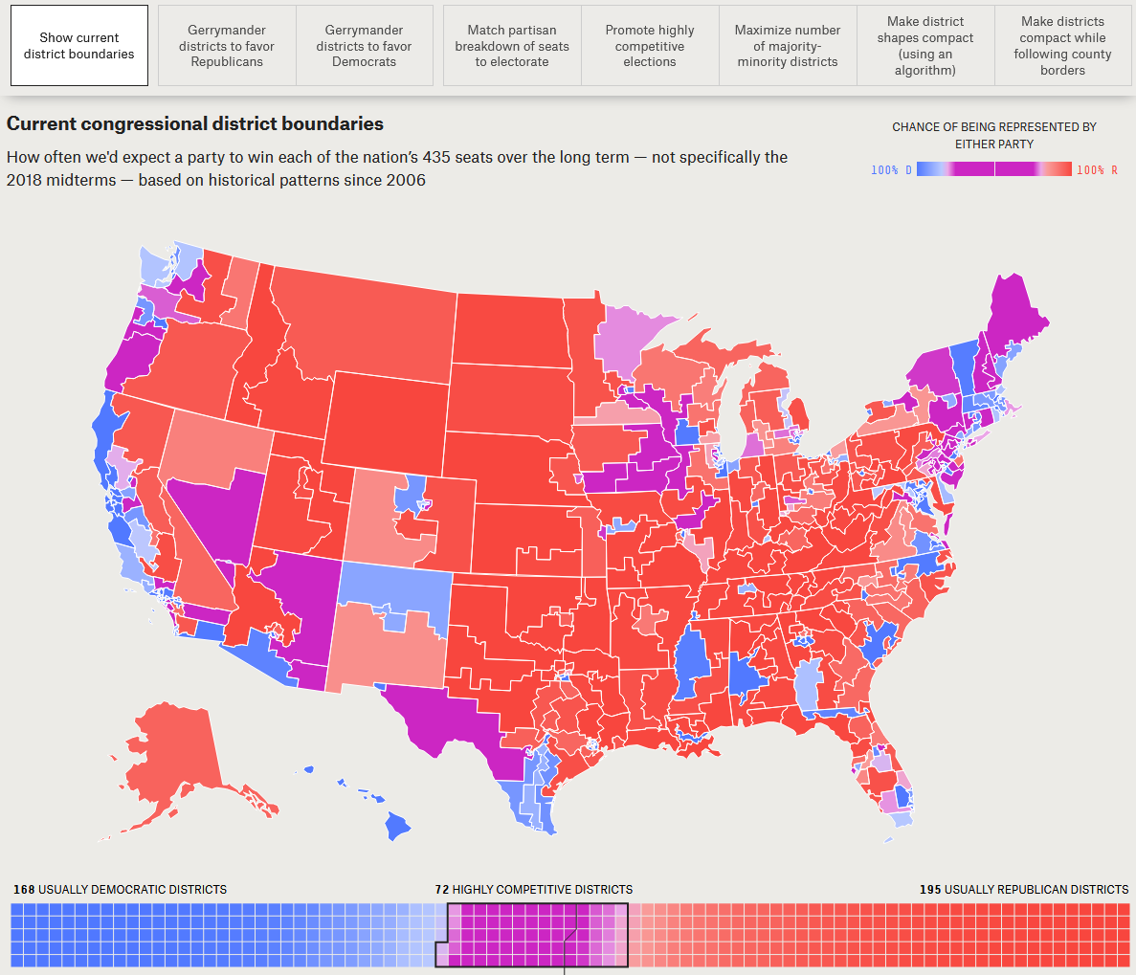
538: Atlas of Redistricting
There’s a lot of complaining about gerrymandering, but what should US Congressional districts look like? What would they look like to serve various goals?
This map shows the current boundaries, with expected wins by Rep and Dem.
Why do I find this app appealing?
From: https://projects.fivethirtyeight.com/redistricting-maps/

Slide 25
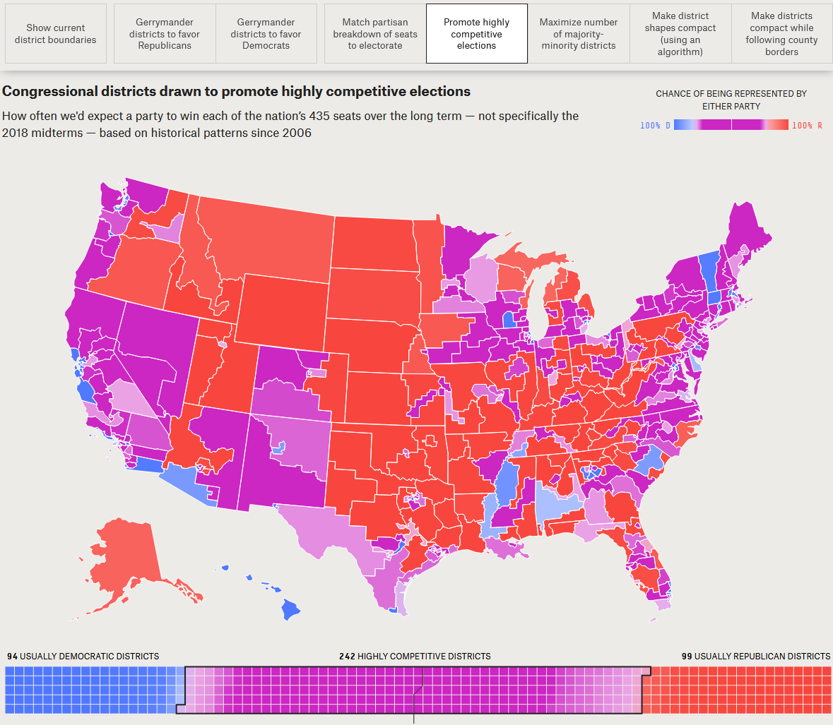
538: Atlas of Redistricting
How could district boundaries be re-drawn to promote more competitive elections?
Election district boundaries are consequential & highly political. They can be changed by state legislatures.
Different scenarios show the changes in representation, w/o a single voter switching parties!
From: https://projects.fivethirtyeight.com/redistricting-maps/

Slide 26
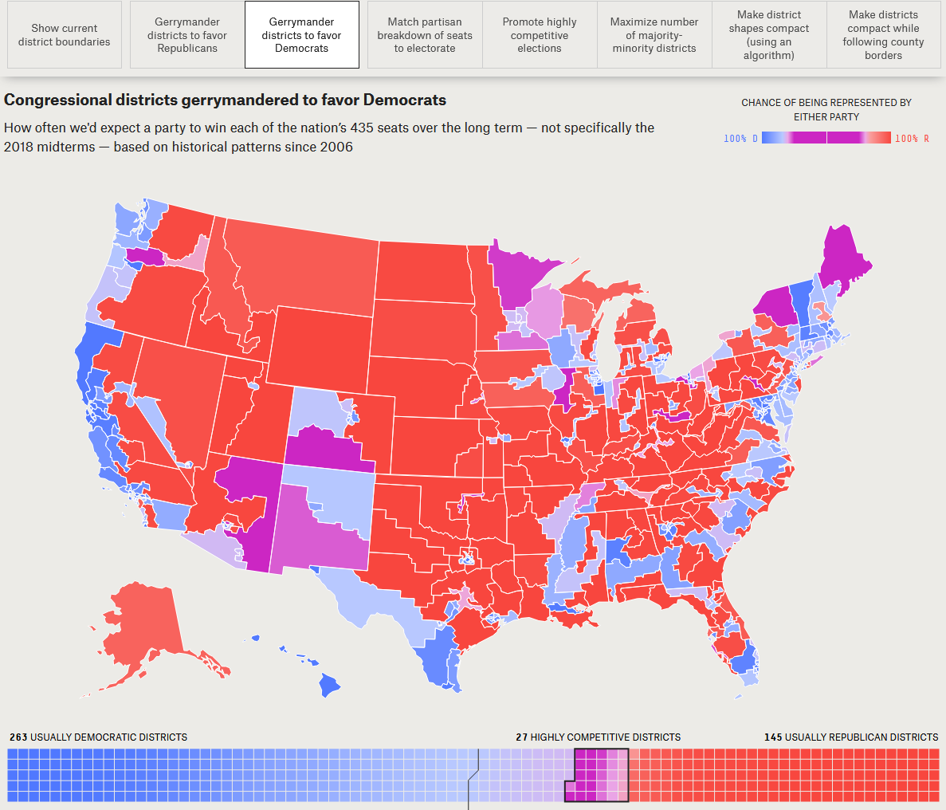
538: Atlas of Redistricting
What if the Democrats could control election districts to favor themselves?
Note that the overall impression of the map is still Rep. overall.
Changes in representation take place largely on the east/west coasts
From: https://projects.fivethirtyeight.com/redistricting-maps/

Slide 27
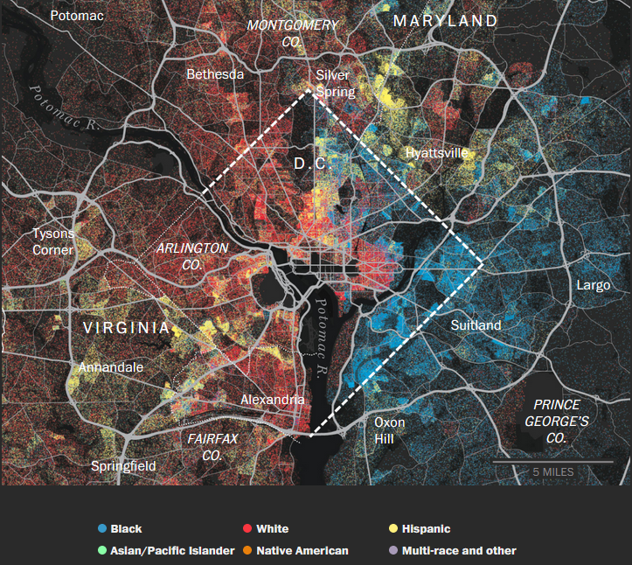
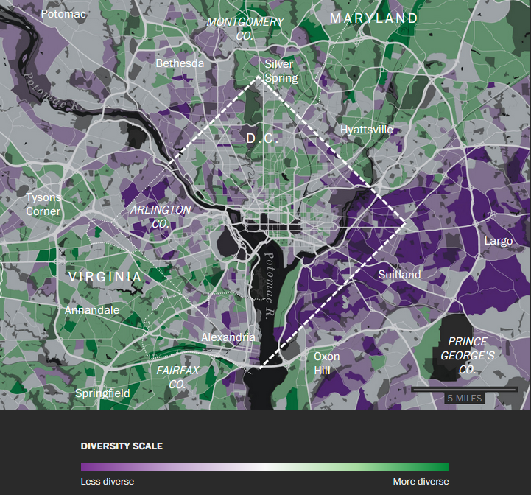
WP: Segregation in U.S. Cities
Aaron Williams & Armand Emamdjomeh at the Washington Post studied changes in racial composition and diversity in U.S. cities over 30+ years
They relate these to demographic, policy, and urban/suburban issues using well-designed thematic maps.
From: https://www.washingtonpost.com/graphics/2018/national/segregation-us-cities/

Slide 28
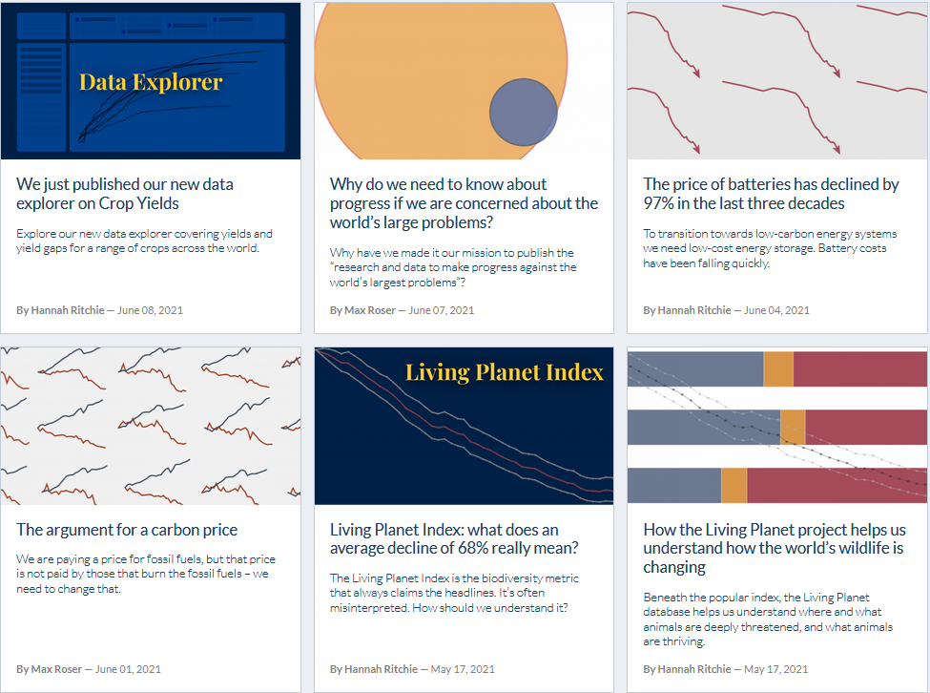
Our World in Data
An impressive range of social & environmental issues presented by Our World in Data

Slide 29

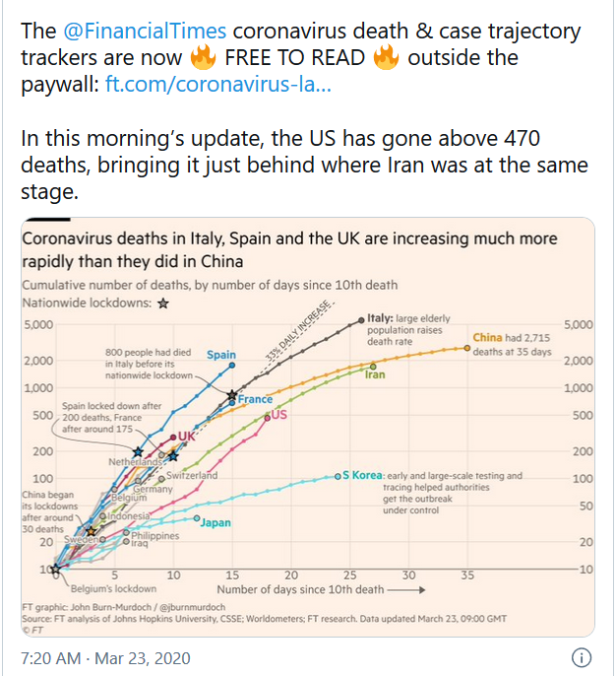
Financial Times COVID tracker
This series of charts from the Financial Times was hailed for best-practices in the early stages of the pandemic.
Log scale make it easy to compare rates of increase
Visual meaning for “leveling the curve”
Labels for interventions (lockdown)
Sensible (relative) origin – days since 10th death

Slide 30

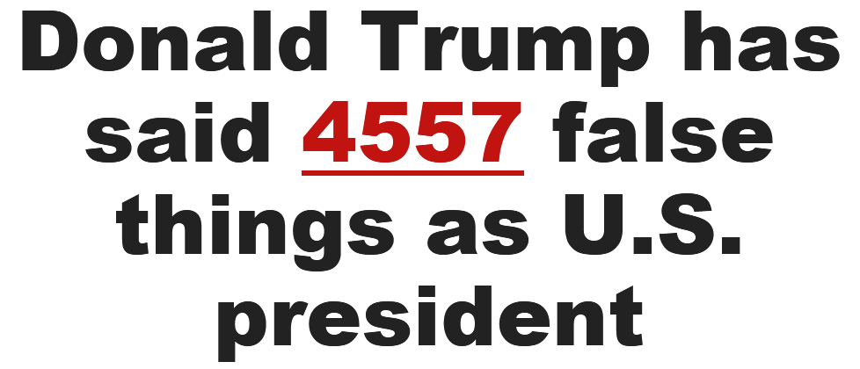
Toronto Star: Trump Lies
Daniel Dale & Ed Tubb at the Toronto Star maintained a database of every false claim made by Donald Trump since the Inauguration on Jan. 20, 2017
(as of 3-13-2019)
Interactive filter at: http://projects.thestar.com/donald-trump-fact-check/

Slide 31
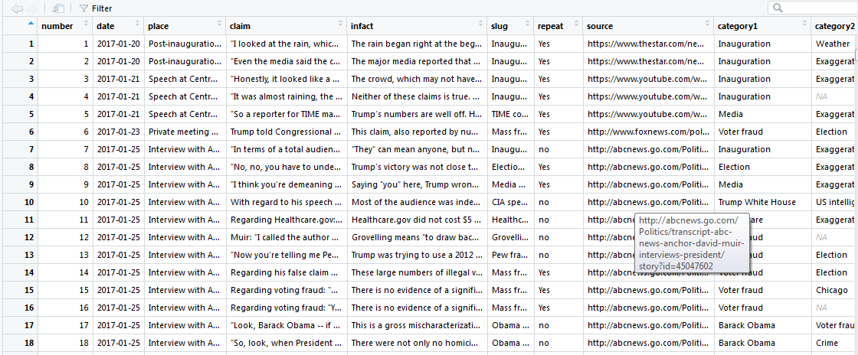
Toronto Star: Trump Lies
Every false claim is documented: place, claim, truth, “slug”, categories
claim
truth
inauguration
media
voter fraud

Slide 32
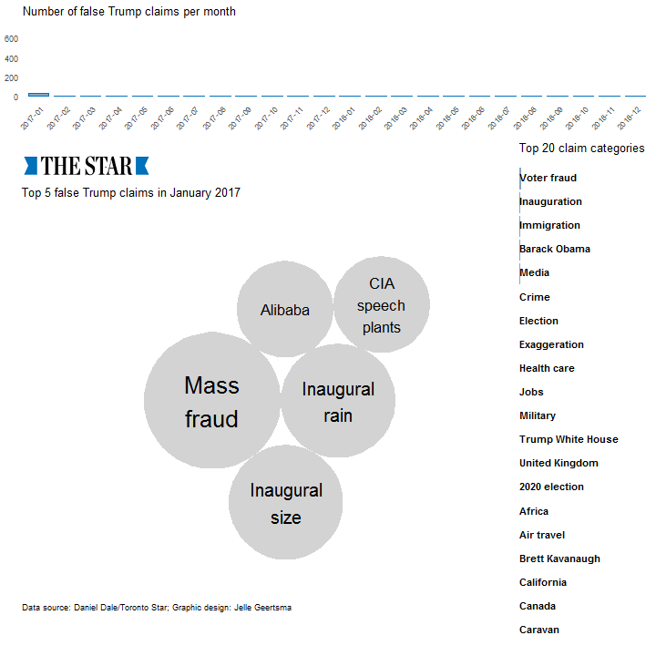
Jelle Geertsma: Trump Lies
Graphic artist Jelle Geertsma designed this animated graphic showing the top 5 claim “slugs” & the top 20 categories over time, by month.
Bars at right show cumulative totals
This animation uses the gganimate package.
A TrumpLies package is in progress. Ugh! Not so.
cumulative totals

Slide 33
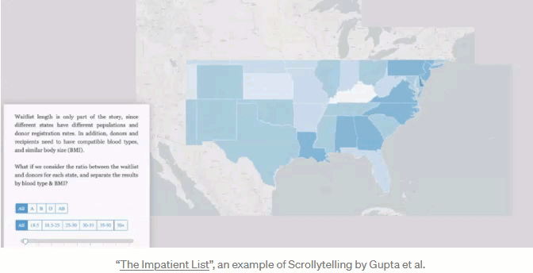
Scrollytelling: The Impatient List
What it’s like waiting for a kidney transplant in the U.S.
From https://xujunjiejack.github.io/

Slide 34
Now trending …
Digital publishing and online, interactive media
Many news organizations have interactive graphic developers or entire online departments
A revenue stream responding to less from print & ads
Story telling frames a wider enterprise
A focus for data visualization
New online forms: scrollytelling
Open data
Maps-GIS (Google, Open Street maps)
Gov’t data: census, health, crime, …
NGO initiatives: Our World in Data
Software infrastructure
Javascript as base for online, interactive methods
Libraries, frameworks building on this (D3.js, Processing, …)

